Slide 1

Unit-04 Data Visualization
Python for Data Science (PDS) (3150713)
Prof. Arjun V. Bala
Computer Engineering Department
arjun.bala@darshan.ac.in
9624822202

Slide 2

Outline
Introduction to MatPlotLib
Graph
Plot
Drawing Multiple Lines and Plots
Export graphs/plots to Image/PDF/SVG
Axis, Ticks ad Grids
Line Appearance
Labels, Annotation, Legends
Types of Graphs
Pie Chart
Bar Chart
Histograms
Boxplots
Scatterplots
Time Series
Plotting Geographical data
Looping

Slide 3
Introduction to MatPlotLib
Most people visualize information better when they see it in graphic versus textual format.
Graphics help people see relationships and make comparisons with greater ease.
Fortunately, python makes the task of converting textual data into graphics relatively easy using libraries, one of most commonly used library for this is MatPlotLib.
Matplotlib is a comprehensive library for creating static, animated, and interactive visualizations in Python.

Slide 4




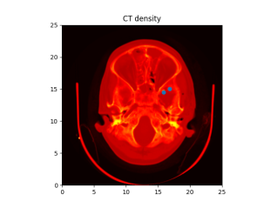
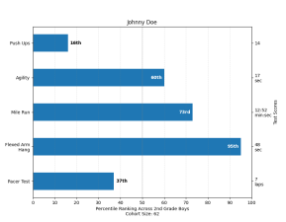
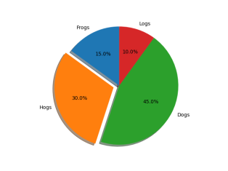
Graph
A Graph or chart is simply a visual representation of numeric data.
MatPlotLib makes a large number of graph and chart types.
We can choose any of the common graph such as line charts, histogram, scatter plots etc....
Line Chart
Histogram
Scatter Plot
3D Plot
Images
Bar Chart
Pie Chart
Etc.......

Slide 5
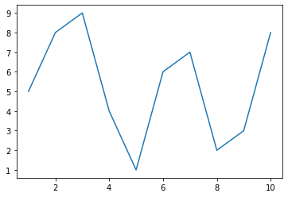
Plot
To define a plot, we need some values, the matplotlib.pyplot module and an idea of what we want to display.
In this case, the code tells the plt.plot() function to create a plot using x-axis between 1 and 11 and y-axis as per values list.
plotDemo1.py
1
2
3
4
5
import matplotlib.pyplot as plt
%matplotlib inline
values = [5,8,9,4,1,6,7,2,3,8]
plt.plot(range(1,11),values)
plt.show()

Slide 6
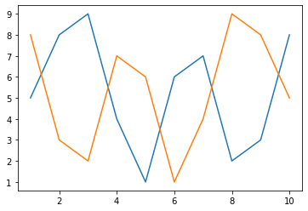
Plot – Drawing multiple lines
We can draw multiple lines in a plot by making multiple plt.plot() calls.
plotDemo1.py
1
2
3
4
5
6
7
import matplotlib.pyplot as plt
%matplotlib inline
values1 = [5,8,9,4,1,6,7,2,3,8]
values2 = [8,3,2,7,6,1,4,9,8,5] plt.plot(range(1,11),values1)
plt.plot(range(1,11),values2)
plt.show()

Slide 7
Plot – Export graphs/plots
We can export/save our plots on a drive using savefig() method.
Possible values for the format parameters are
png
svg
pdf
Etc...
plotDemo1.py
1
2
3
4
5
6
7
8
import matplotlib.pyplot as plt
%matplotlib inline
values1 = [5,8,9,4,1,6,7,2,3,8]
values2 = [8,3,2,7,6,1,4,9,8,5]
plt.plot(range(1,11),values1)
plt.plot(range(1,11),values2)
#plt.show()
plt.savefig('SaveToPath.png',format='png')
SaveToPath.png

Slide 8
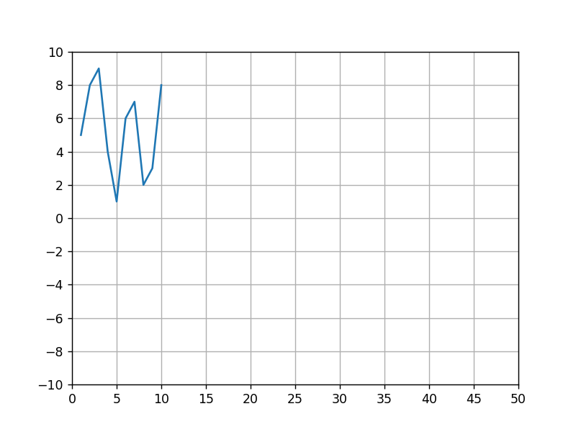
Plot – Axis, Ticks and Grid
We can access and format the axis, ticks and grid on the plot using the axis() method of the matplotlib.pyplot.plt
plotDemo1.py
1
2
3
4
5
6
7
8
9
10
import matplotlib.pyplot as plt
%matplotlib notebook
values = [5,8,9,4,1,6,7,2,3,8]
ax = plt.axes()
ax.set_xlim([0,50])
ax.set_ylim([-10,10])
ax.set_xticks([0,5,10,15,20,25,30,35,40,45,50])
ax.set_yticks([-10,-8,-6,-4,-2,0,2,4,6,8,10])
ax.grid()
plt.plot(range(1,11),values)

Slide 9
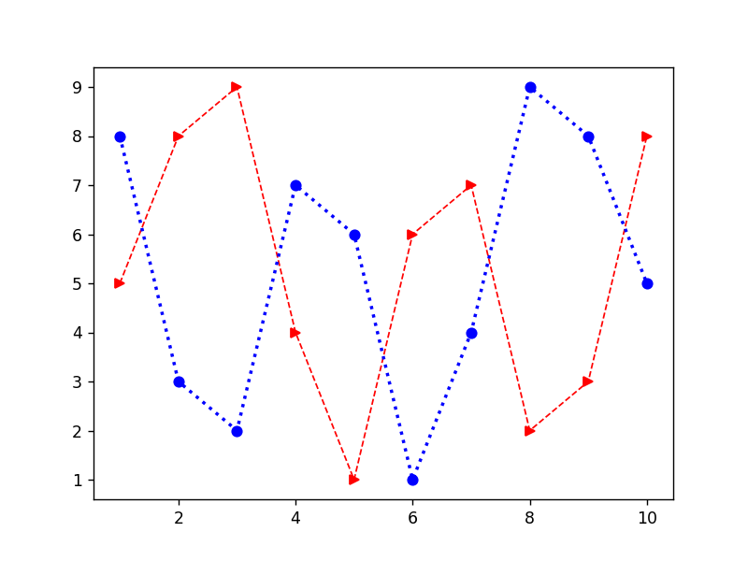
Plot – Line Appearance
We need different line styles in order to differentiate when having multiple lines in the same plot, we can achieve this using many parameters, some of them are listed below.
Line style (linestyle or ls)
Line width (linewidth or lw)
Line color (color or c)
Markers (marker)
plotDemo1.py
1
2
3
4
5
6
7
import matplotlib.pyplot as plt
%matplotlib inline
values1 = [5,8,9,4,1,6,7,2,3,8]
values2 = [8,3,2,7,6,1,4,9,8,5] plt.plot(range(1,11),values1,c='r',lw=1,ls='--',marker='>')
plt.plot(range(1,11),values2,c='b',lw=2,ls=':',marker='o')
plt.show()

Slide 10
Plot – Line Appearance (Cont.)
Possible Values for each parameters are,
Values | Line Style
‘-’ | Solid line
‘--’ | Dashed line
‘-.’ | Dash-dot line
‘:’ | Dotted line
Values | Color
‘b’ | Blue
‘g’ | Green
‘r’ | Red
‘c’ | Cyan
‘m’ | Magenta
‘y’ | Yellow
‘k’ | Black
‘w’ | White
Values | Marker
‘.’ | Point
‘,’ | Pixel
‘o’ | Circle
‘v’ | Triangle down
‘^’ | Triangle up
‘>’ | Triangle right
‘<’ | Triangle left
‘*’ | Star
‘+’ | Plus
‘x’ | X
Etc.......

Slide 11
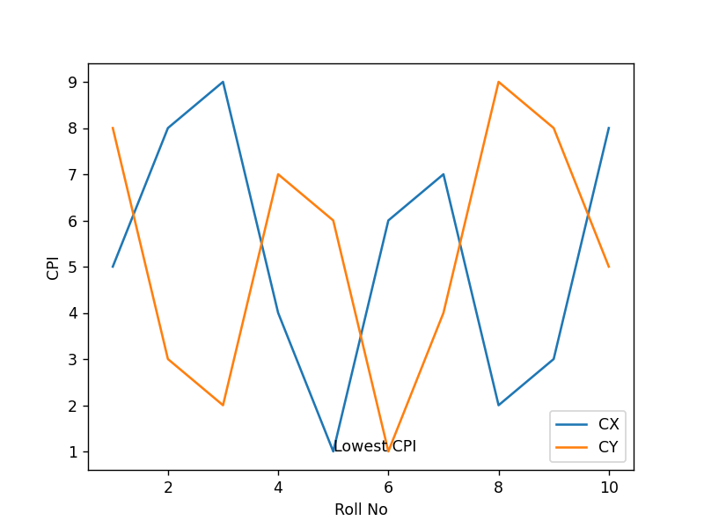
Plot – Labels, Annotation and Legends
To fully document our graph, we have to resort the labels, annotation and legends.
Each of this elements has a different purpose as follows,
Label : provides identification of a particular data element or grouping, it will make easy for viewer to know the name or kind of data illustrated.
Annotation : augments the information the viewer can immediately see about the data with notes, sources or other useful information.
Legend : presents a listing of the data groups within the graph and often provides cues ( such as line type or color) to identify the line with the data.
Y Label
Annotation
Legend
X Label

Slide 12
Plot – Labels, Annotation and Legends (Example)
plotDemo1.py
1
2
3
4
5
6
7
8
9
10
11
import matplotlib.pyplot as plt
%matplotlib inline
values1 = [5,8,9,4,1,6,7,2,3,8]
values2 = [8,3,2,7,6,1,4,9,8,5]
plt.plot(range(1,11),values1)
plt.plot(range(1,11),values2)
plt.xlabel('Roll No')
plt.ylabel('CPI')
plt.annotate(xy=[5,1],s='Lowest CPI')
plt.legend(['CX','CY'],loc=4)
plt.show()

Slide 13
Choosing the Right Graph
The kind of graph we choose determines how people view the associated data, so choosing the right graph from the outset is important.
For example,
if we want o show how various data elements contribute towards a whole, we should use pie chart.
If we want to compare data elements, we should use bar chart.
If we want to show distribution of elements, we should use histograms.
If we want to depict groups in elements, we should use boxplots.
If we want to find patterns in data, we should use scatterplots.
If we want to display trends over time, we should use line chart.
If we want to display geographical data, we should use basemap.
If we want to display network, we should use networkx.
All the above graphs are there in our syllabus and we are going to cover all the graphs in this Unit.
We are also going to cover some other types of libraries which is not in the syllabus like seaborn, plotly, cufflinks and choropleth maps etc..

Slide 14
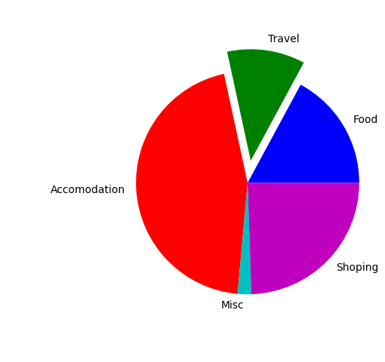
Pie Chart
Pie chart focus on showing parts of a whole, the entire pie would be 100 percentage, the question is how much of that percentage each value occupies.
pieChartDemo.py
1
2
3
4
5
6
7
8
import matplotlib.pyplot as plt
%matplotlib notebook
values = [305,201,805,35,436]
l = ['Food','Travel','Accomodation','Misc','Shoping']
c = ['b','g','r','c','m']
e = [0,0.2,0,0,0]
plt.pie(values,colors=c,labels=l,explode=e)
plt.show()

Slide 15
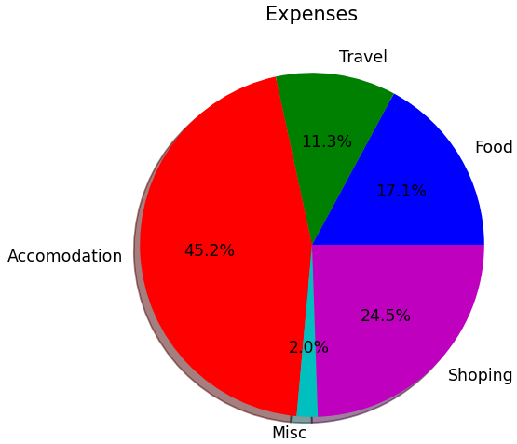
Pie Chart (Cont.)
There are lots of other options available with the pie chart, we are going to cover two important parameters in this slide.
pieChartDemo.py
1
2
3
4
5
6
7
8
import matplotlib.pyplot as plt
%matplotlib notebook
values = [305,201,805,35,436]
l = ['Food','Travel','Accomodation','Misc','Shoping']
c = ['b','g','r','c','m']
plt.pie(values,colors=c,labels=l,shadow=True,
autopct='%1.1f%%')
plt.show()

Slide 16
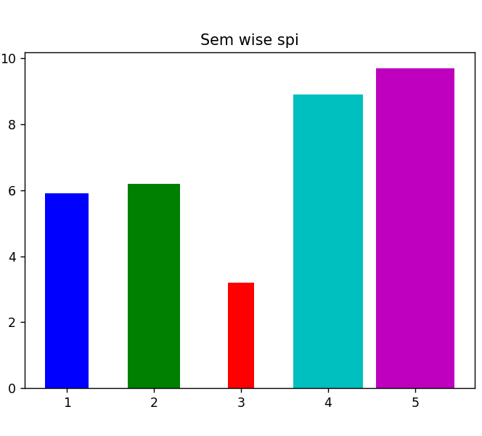
Bar charts
Bar charts make comparing values easy, wide bars an d segregated measurements emphasize the difference between values, rather that the flow of one value to another as a line graph.
barChartDemo.py
1
2
3
4
5
6
7
8
9
10
import matplotlib.pyplot as plt
%matplotlib notebook
x = [1,2,3,4,5]
y = [5.9,6.2,3.2,8.9,9.7]
l = ['1st','2nd','3rd','4th','5th']
c = ['b','g','r','c','m']
w = [0.5,0.6,0.3,0.8,0.9]
plt.title('Sem wise spi')
plt.bar(x,y,color=c,label=l,width=w)
plt.show()

Slide 17
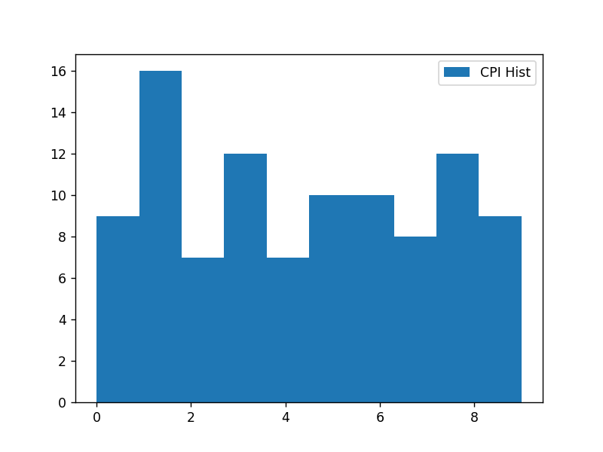
Histograms
Histograms categorize data by breaking it into bins, where each bin contains a subset of the data range.
A Histogram then displays the number of items in each bin so that you can see the distribution of data and the progression of data from bin to bin.
histDemo.py
1
2
3
4
5
6
7
import matplotlib.pyplot as plt
import numpy as np
%matplotlib notebook
cpis = np.random.randint(0,10,100)
plt.hist(cpis,bins=10, histtype='stepfilled',align='mid',label='CPI Hist')
plt.legend()
plt.show()

Slide 18
Boxplots
Boxplots provide a means of depicting groups of numbers through their quartiles.
Quartiles means three points dividing a group into four equal parts.
In boxplot, data will be divided in 4 part using the 3 points (25th percentile, median, 75th percentile)
Interquartile Range
(IQR)
Outliers
Whiskers
Whiskers
Outliers
Minimum
(Q1 – 1.5 * IQR)
Maximum
(Q3 + 1.5 * IQR)
Median
Q1
(25th Percentile)
Q2
(50th Percentile)
Q3
(75th Percentile)
-5
-4
-3
-2
-1
0
1
2
3
4
5

Slide 19
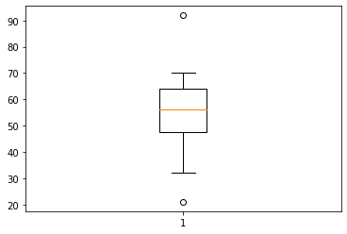
Boxplot (Cont.)
Boxplot basically used to detect outliers in the data, lets see an example where we need boxplot.
We have a dataset where we have time taken to check the paper, and we want to find the faculty which either takes more time or very little time to check the paper.
We can specify other parameters like
widths, which specify the width of the box
notch, default is False
vert, set to 0 if you want to have horizontal graph
boxDemo.py
1
2
3
4
5
import pandas as pd
import matplotlib.pyplot as plt
%matplotlib inline
timetaken = pd.Series([50,45,52,63,70,21,56,68,54,57,35,62,65,92,32])
plt.boxplot(timetaken)

Slide 20
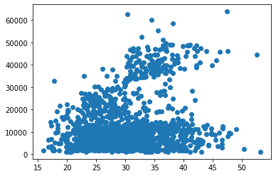
Scatter Plot
A scatter plot is a type of plot that shows the data as a collection of points.
The position of a point depends on its two-dimensional value, where each value is a position on either the horizontal or vertical dimension.
It is really useful to study the relationship/pattern between variables.
histDemo.py
1
2
3
4
5
6
import matplotlib.pyplot as plt
import pandas as pd
%matplotlib inline
df = pd.read_csv('insurance.csv')
plt.scatter(df['bmi'], df['charges'])
plt.show()

Slide 21
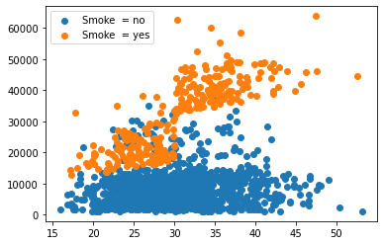
Scatter Plot (Cont.)
To find specific pattern from the data, we can further divide the data and plot scatter plot.
We can do this with the help of groupby method of DataFrame, and then using tuple unpacking while looping the group.
Note : we can specify marker, color, and size of the marker with the help
of marker, color and s parameter respectively.
histDemo.py
1
2
3
4
5
6
7
8
9
import matplotlib.pyplot as plt
import pandas as pd
%matplotlib inline
df = pd.read_csv('insurance.csv')
grouped = df.groupby(['smoker'])
for key, group in grouped:
plt.scatter(group['bmi'],
group['charges'],
label='Smoke = '+key)
plt.legend()
plt.show()

Slide 22
Time Series
Observations over time can be considered as a Time Series.
Visualization plays an important role in time series analysis and forecasting.
Time Series plots can provide valuable diagnostics to identify temporal structures like trends, cycles, and seasonality.
In order to create a Time Series we first need to get the date range, which can be created with the help of datetime and pandas library.
timeDemo.py
OUTPUT
1
2
3
4
5
6
import pandas as pd
import datetime as dt
start_date = dt.datetime(2020,8,28)
end_date = dt.datetime(2020,9,05)
daterange = pd.date_range(start_date,end_date)
print(daterange)
DatetimeIndex(['2020-08-28', '2020-08-29', '2020-08-30', '2020-08-31', '2020-09-01', '2020-09-02', '2020-09-03', '2020-09-04', '2020-09-05'],
dtype='datetime64[ns]', freq='D')

Slide 23
Time Series (Cont.)
We can use some more parameters for date_range() function like
freq, to specify the frequency at which we want the date range (default is ‘D’ for days)
periods, number of periods to generate in between start/end or from start with freq.
We can also create a date range with the help of startdate, periods and freq, for example
Some of important possible values for the freq are
D, for calendar day
W, for week
M, for month
Y, for year
timeDemo.py
OUTPUT
1
2
3
4
5
6
import pandas as pd
import datetime as dt
start_date = dt.datetime(2020,8,28)
daterange = pd.date_range(start_date,freq='D',periods=10)
print(daterange)
DatetimeIndex(['2020-08-25', '2020-08-26', '2020-08-27', '2020-08-28', '2020-08-29', '2020-08-30', '2020-08-31', '2020-09-01', '2020-09-02', '2020-09-03'],
dtype='datetime64[ns]', freq='D')
H, for hour
T/min, for minute
S, for seconds
L, for milliseconds
B, for business day
SM, for semi month end
Q, for quarter end
BQ, for business quarter end

Slide 24
Basemap
The matplotlib basemap toolkit is a library for plotting 2D data on maps in Python.

Slide 25
NetworkX
We can use networkx library in order to deal with any kind of networks, which includes social network, railway network, road connectivity etc….
Install
pip install networkx
conda install networkx
Types of network graph
Undirected
Directed
Weighted graph

Slide 26
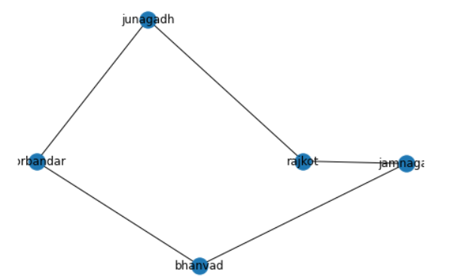
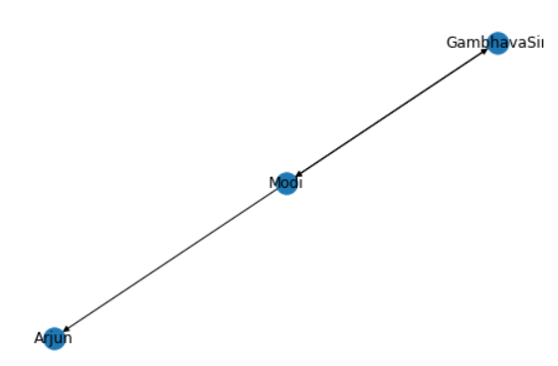
NetworkX (example)
networkxDemo.py
1
2
3
4
5
6
7
8
import networkx as nx
g = nx.Graph() # undirected graph
g.add_edge('rajkot','junagadh')
g.add_edge('junagadh','porbandar')
g.add_edge('rajkot','jamnagar')
g.add_edge('jamnagar','bhanvad')
g.add_edge('bhanvad','porbandar')
nx.draw(g,with_labels=True)
networkxDemo.py
1
2
3
4
5
6
7
import networkx as nx
gD = nx.DiGraph() # directed graph
gD.add_edge('Modi','Arjun')
gD.add_edge('Modi','GambhavaSir')
gD.add_edge('GambhavaSir','Modi')
nx.draw(gD, with_labels=True)

Slide 27
NetworkX (cont.)
We can use many analysis functions available in NetworkX library, some of functions are as below
nx.shortest_path(g,'rajkot','porbandar')
Will return ['rajkot', 'junagadh', 'porbandar']
nx.clustering(g)
Will return clustering value for each node
nx.degree_centrality(g)
Will return the degree of centrality for each node, we can find most popular/influential node using this method.
nx.density(g)
Will return the density of the graph.
The density is 0 for a graph without edges and 1 for a complete graph.
nx.info(g)
Return a summary of information for the graph G.
The summary includes the number of nodes and edges, and their average degree.

